Slide 1
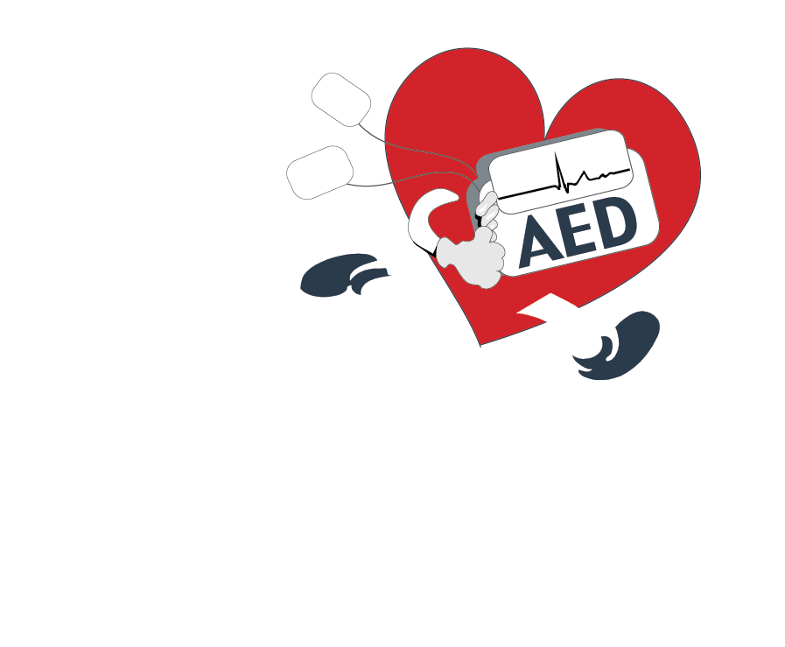
2022 Instructor Course

Slide 2
Welcome!
Introductions
Notes:
Pam

Slide 3
AED Institute’s Mission & Overview
The mission of AED Institute is to promote within the community, the science and education of early defibrillation and CPR
18 years of AED sales and service experience
Small, woman-owned company
AED leader in Hawaii

Slide 4
What to Expect
Day 1
Day 2
Day 3
Day 4
Future

Slide 5
Glossary
Training Centers - are entities approved by the AHA. They are responsible for the proper administration and quality of AHA courses provided by their aligned instructors. All instructors must be aligned with a TC.
Training Faculty - Training Faculty (TF) serve as quality assurance and educational leadership for the TC. In addition to conducting instructor courses, Training Faculty monitor, update, and coach instructors.
Training Site Coordinator - Training Site Coordinators (TSCs) represent the TS. They serve as the primary contact between the TS and the TC.

Slide 6
AHA Training Network
Notes:
Training Centers - are entities approved by the AHA. They are responsible for the proper administration and quality of AHA courses provided by their aligned instructors. All instructors must be aligned with a TC.
Training Faculty - Training Faculty (TF) serve as quality assurance and educational leadership for the TC. In addition to conducting instructor courses, Training Faculty monitor, update, and coach instructors.
Training Site Coordinator - Training Site Coordinators (TSCs) represent the TS. They serve as the primary contact between the TS and the TC.

Slide 8
Overview of BLS Course
Audience:
Healthcare professionals
Seniors going into the healthcare field
Course overview:
Basic lifesaving skills
High-quality CPR
1-rescuer and 2-rescuer BLS skills for adults, children and infants

Slide 9
Overview of Heartsaver Courses
Audience:
The Heartsaver courses are designed for anyone with limited or no medical training. Many students need a course completion card to meet job, regulatory, or other requirements. Students should check with their agency or workplace to ensure that the course fulfills their requirements.
What does this course teach?
First aid basics
Medical emergencies
Injury emergencies
Environmental emergencies
Preventing illness and injury
Adult CPR and AED use
Opioid-associated life-threatening emergencies
Child CPR AED and Infant CPR

Slide 10
Heartsaver Course Offerings
Heartsaver First Aid CPR AED Course
Heartsaver CPR AED
Heartsaver First Aid (often paired with BLS)
Heartsaver Pediatric First Aid CPR AED
Designed especially for day care workers and other childcare professionals.
Heartsaver Bloodborne Pathogens
Designed to teach employees how to protect themselves and others from being exposed to blood or blood-containing materials.
Heartsaver K-12 for Schools

Slide 11
Additional Course Options
Knowledge vs. course completion card

Slide 12
Required Instructor Materials
Instructor manual
Provider manual or student workbook
Course videos
DVD, USB or digital

Slide 13
How to Find Information
Your instructor manual
AED Institute Instructor Resource Site
AHA Instructor Network
Program Administration Manual (PAM)

Slide 14
Required Forms
Course rosters: After each course, you’ll need to turn one in. The rosters are available on the Instructor Network or the AED Institute Instructor Portal. All students MUST sign in on the official roster and this roster must be kept and uploaded into Enrollware.
Course evaluations: Every instructor is required to give their students a course evaluation to complete at the end of the course. Course evaluation sheets are available on the Instructor Network or the AED Institute Instructor Resource Site.
Other forms: Nearly every form you’ll need is available on the AED Institute Resource Site.

Slide 15
Book & Card Policy
We no longer stock hard copy books
eCards, eBooks & online keys must be ordered in batches of 10
eCards must be issued to students no later than 20 days after the class
You can have students order online keycodes directly from AHA
Instructors should be issuing their own AHA eCards
Tutorial in the Instructor Portal

Slide 16
Equipment Requirements
AED trainer with adult and pediatric pads - 1 per 6 student group
Manikins - adult/child, infant - 1 per 3 student group
Stopwatch - 1 per instructor
Video player and monitor or screen - 1 per class
Manikin cleaning supplies - 1 set per class
*2022 AHA Instructor Equipment in appendix

Slide 17
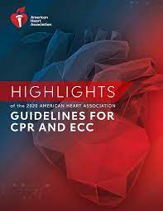
Science Updates 2020
New Information on:
Drug Overdoses
Cardiac Arrest and Pregnancy
New ventilation rates for children
Epinephrine earlier in non-shockable rhythms
Please review this document, it can be found on the AHA Instructor Network & AEDInstitue.com

Slide 18
Priorities of CPR
Right Rate-100-120 compressions per minute
Right Depth-at least 2” or half the depth of the chest
Full Recoil-no leaning on the chest
Minimize interruptions-Improve CCF as much as possible, aim for 80%+
Avoid excessive ventilations!

Slide 20
Hawaii Protocols
Increasing CCF (pages 12-15)
2020 BLS Instructor Manual, Part 5, Lesson 6A and Part 6, Lesson 5A
BLS continuous compression skills sheet
Chest Compression Fractions

Slide 21
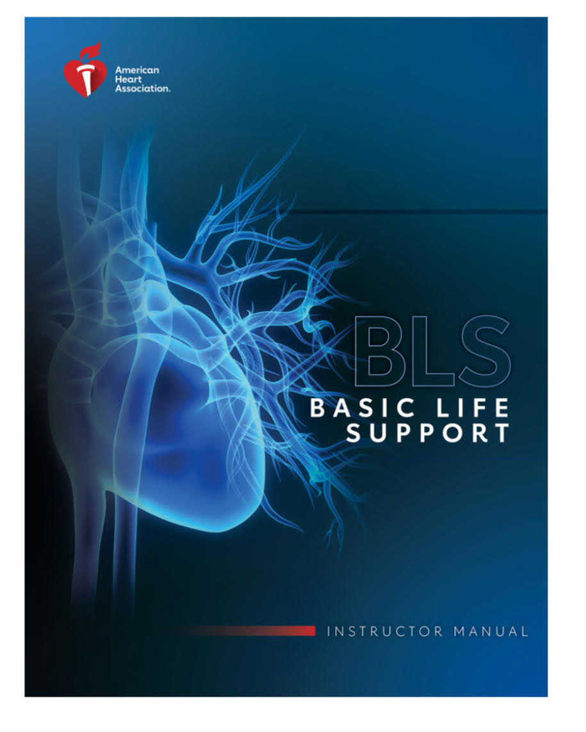
2020 BLS Instructor Manual, Part 5, Lesson 6A and Part 6, Lesson 5A

Slide 22
2020 BLS Instructor Manual, Part 5, Lesson 6A and Part 6, Lesson 5A

Slide 23
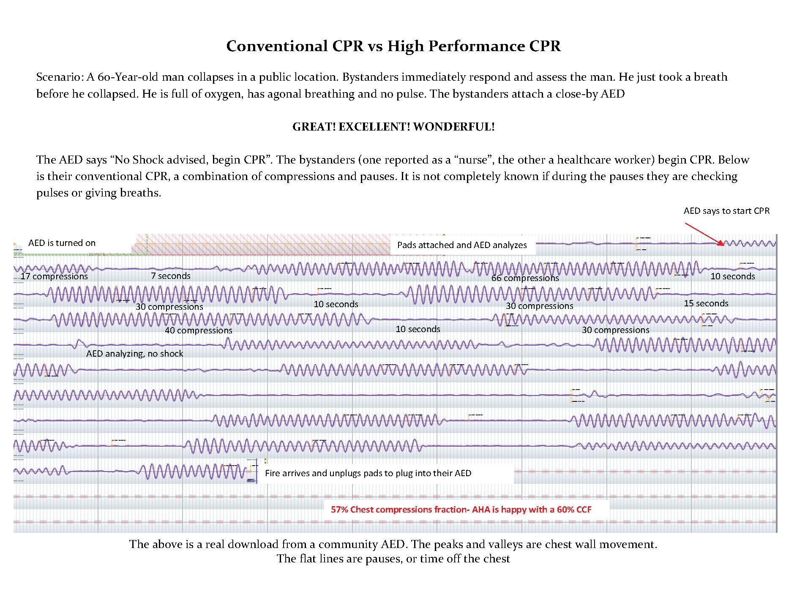

Slide 24
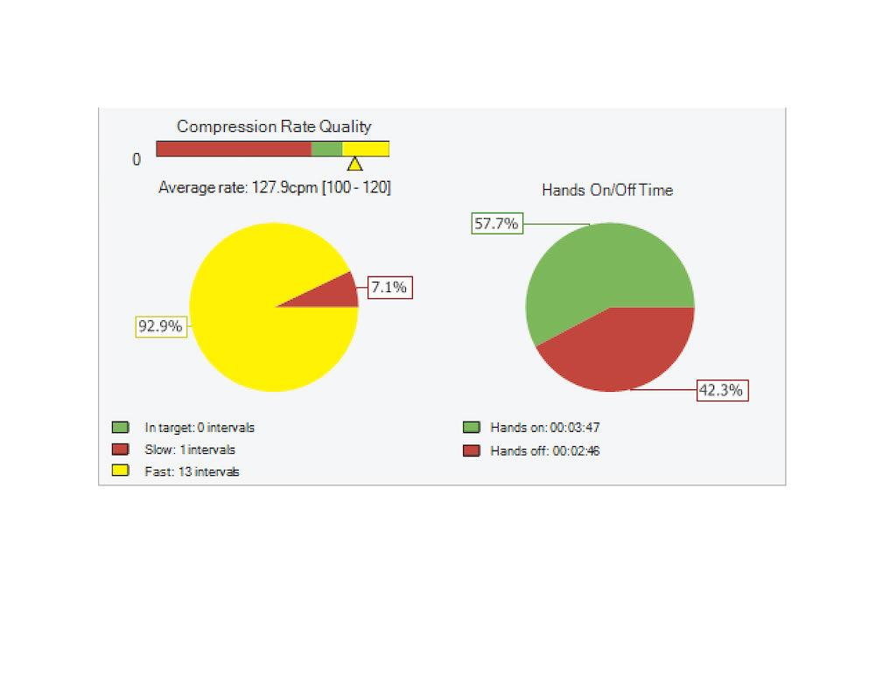

Slide 25
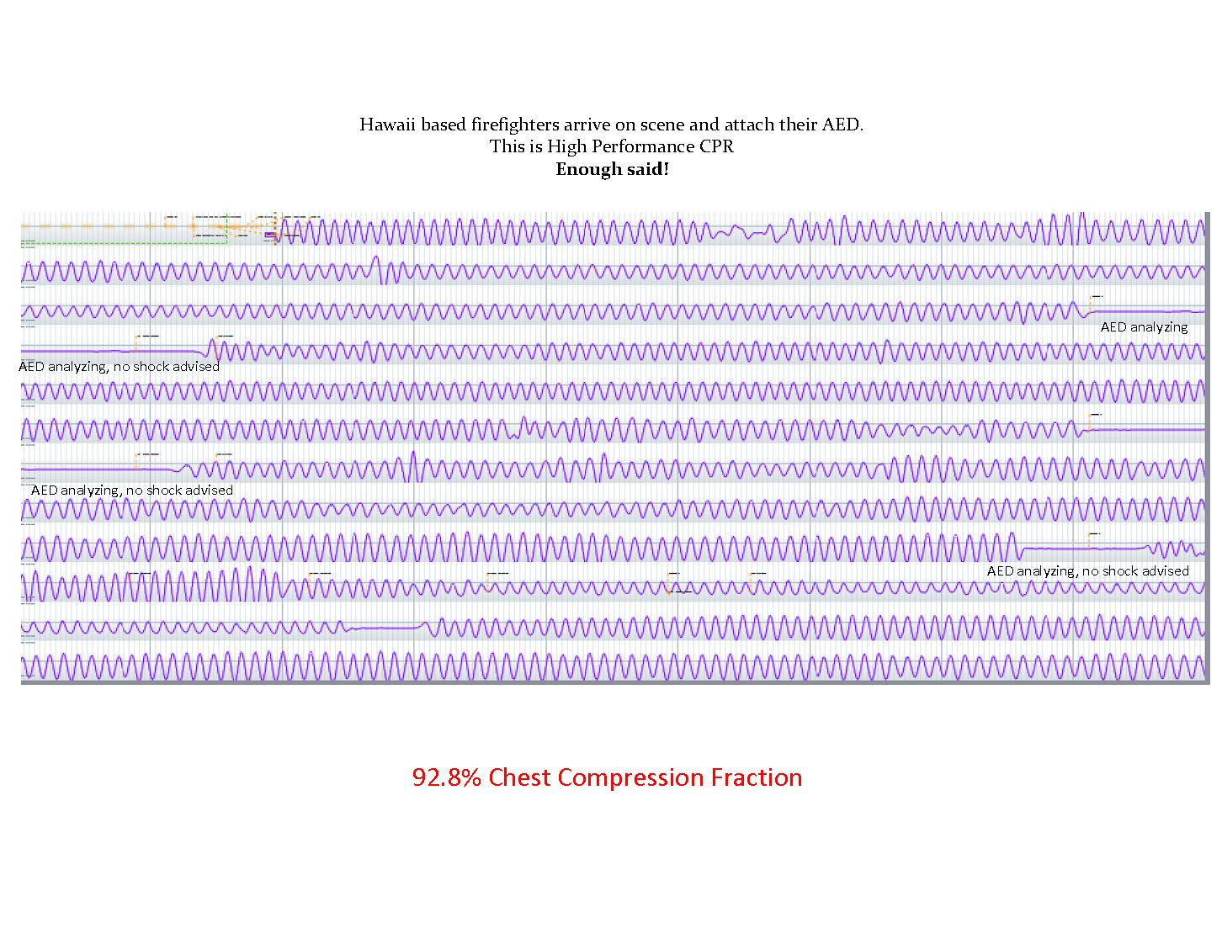

Slide 26
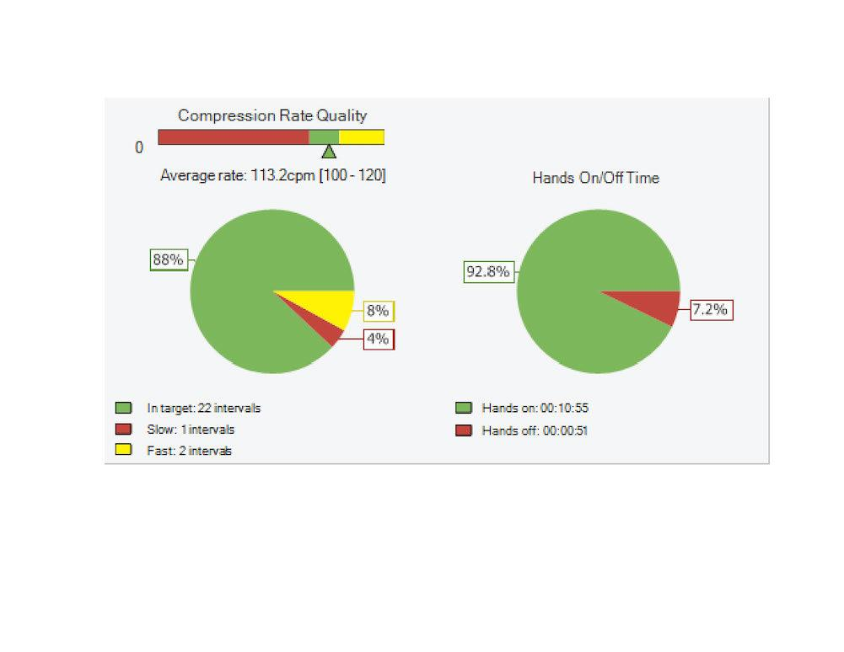

Slide 27
Mandatory Requirements
It is a mandatory requirement that in every CPR/AED class that adult, child, and infant CPR is taught to all students.
Every student must know how to respond to potential victims of every size.
Feedback manikin requirements
Since January 31, 2019 AHA requires the use of an instrumented directive feedback device and/or manikins in all AHA courses that teach the skills of CPR.

Slide 28
Course Delivery Options
Full classroom
Weekly sessions
Delivery options
Time
Student materials
Blended learning (Heartcode)
Time
Student materials

Slide 29
Preparing the Classroom
AHA room requirements:
Good acoustics
Video player or internet connection
Monitor or screen
Well-maintained environment
Once you know the number of students attending the course, you can determine the amount of equipment and materials you’ll need.

Slide 30
Facilitate Classes
Observe & coach - provide positive, corrective feedback
Immediate feedback - feedback helps form good habits and corrects errors to ensure accurate skills performance
Short & focused - provide short and focused feedback

Slide 31
Lesson Plans
Lesson plans serve as a guide for you to teach AHA courses, providing direction on the actions you need to take as an instructor.
Approximate length of time for each lesson
Learning objectives
Instructor tips
Guidance for following along with the videos
Step-by-step instructions

Slide 32
Skills Testing
Skills testing ensures that students can demonstrate what they’ve learned.
The skills testing checklists identify specific behaviors you should observe during skills practice and testing.

Slide 33
Remediation
If a student does not properly demonstrate a skill, you may need to provide remediation.
This doesn’t mean assisting the student through a skills test. Instead, you may need to replay sections of the video and provide additional practice time.
Then, offer an opportunity to retake the skills test.

Slide 34
Exams
HeartCode BLS has a cognitive assessment incorporated into the online portion, so an exam does not need to be given to students when they attend the classroom portion.
Students in the instructor-led BLS Course are required to take an exam to measure cognitive knowledge.
For Heartsaver students, some employers or agencies may require students to complete an exam; otherwise, the exam is optional. Both the student and the instructor are responsible for knowing if a student needs to take the exam.
Students must score at least 84% to pass either exam. If they don’t, you should provide remediation for that student before they retake the test.

Slide 35
Post-Course
Upload the following into Enrollware:
Completed (signed) roster
Exam answer sheets (if applicable)
Course evaluations
Decontaminate all equipment and manikins
Issue eCards to students within 20 days

Slide 36
Enrollware
Resource: Enrollware Guide in Appendix
How to access - enrollware.com
What is it used for?
Creating classes
Printing rosters
Uploading & storing documents
Finalizing classes

Slide 37
AHA Network
How to access - https://ahainstructornetwork.americanheart.org/
What is it used for?
Issuing AHA eCards to students
Accessing the Program Administration Manual (PAM)
Accessing course documents - evaluations, rosters, skills sheets

Slide 38
AED Institute Instructor Resource Site
How to access - https://aedinstitute.wixsite.com/instructors
aedinstitute.com | Instructors
What is it used for?
Course documents - evaluations, rosters, skills sheets
Supplementary videos
Instructor tutorials & guides
Instructor tutorial videos
Student resources

Slide 39
Course Completion Card
How to order
Send an email to training@aedinstitute.com
Options & pricing
2022 Enrollware & eCard Guide
How to issue
AHA Network vs. Direct Connect

Slide 40
Instructor Scores
Instructor Scores: Must be 84% or higher (page 18)
Annual Review
Self-Review
Notifying students how to complete ecard surveys
Ideas on how to increase survey numbers (a skipped survey or bypass survey counts as a zero)
Reminders to students
Must be 10 of more students for scores to populate

Slide 41
Great Videos

Slide 42
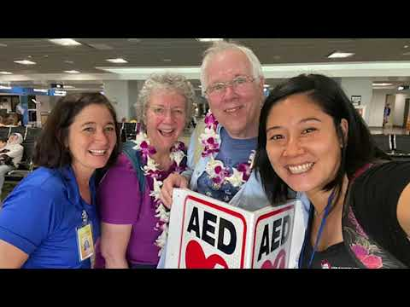
Great Videos

Slide 43
Keep Current
Instructor resources
Annual updates
Requirements to maintain instructor status:
Teach at least 4 classes in 2 years
Minimum eCards score of 85%
Monitoring

Slide 44
Teaching Outside Training Site
Must have personal liability insurance per AHA (page 19)
Must have permission from TS
Must have equipment
Must have your own cards

Slide 45
Additional Opportunities
Teaching under AED Institute - application
Teaching with Kids4CPR
Books available for free
BWRAG sessions

Slide 46
Day 1 Wrap-up
Questions

Slide 47
Day 2 - Introductions
BLS Course
Skills Practice
Scenario Practice

Slide 48
Debrief from BLS Course
Thoughts? How did you like the class?
Thoughts on the equipment? How does this differ from your classes in the past?
How does this differ from community or Heartsaver classes?

Slide 49
Conducting a Scenario Practice
Choose a card
Prepare equipment for practice teaching sessions (15 minutes)
Look over lesson plan (5 minutes)
Plan how you will conduct your training
Ask questions!!!
Let’s Teach!
Notes:
Run through second skills session with each instructor

Slide 50
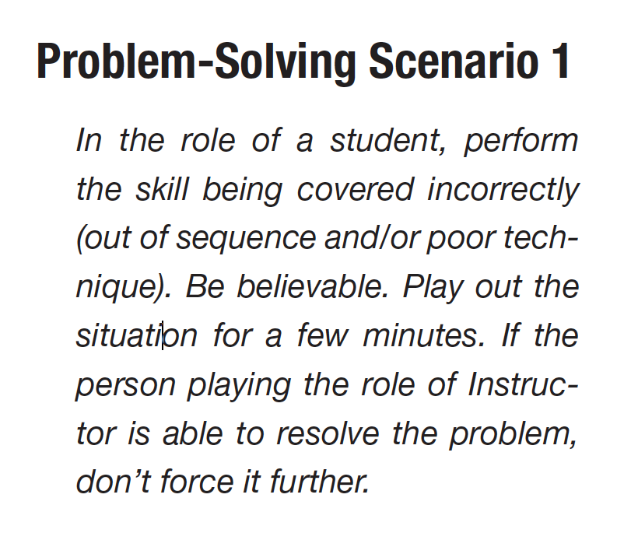
Problem Solving Scenario 1

Slide 51
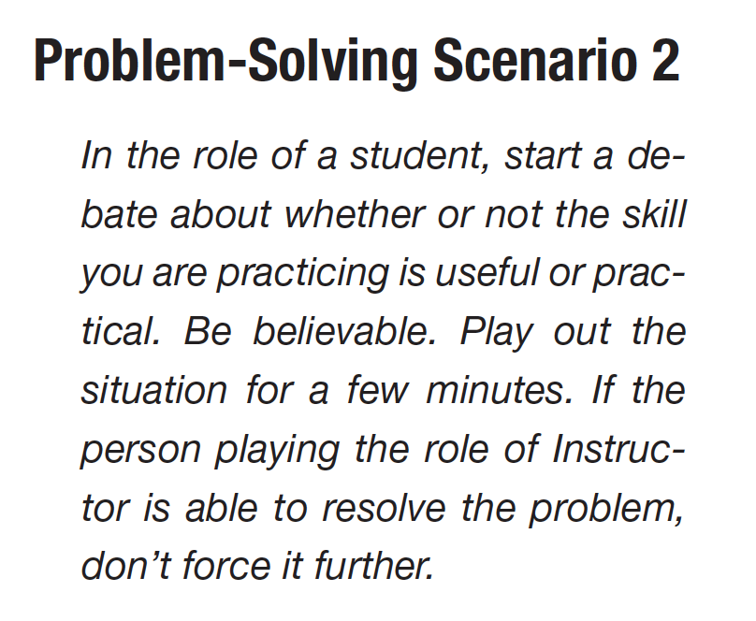
Problem Solving Scenario 2

Slide 52
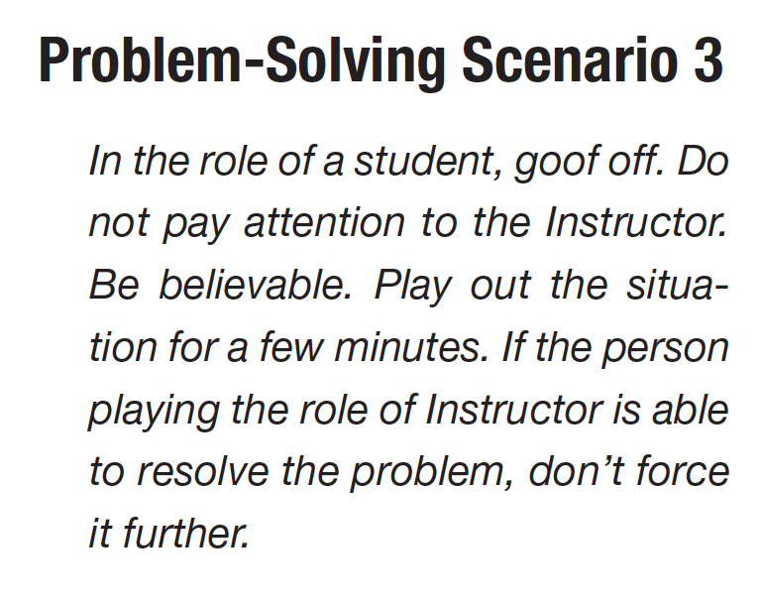
Problem Solving Scenario 3

Slide 53
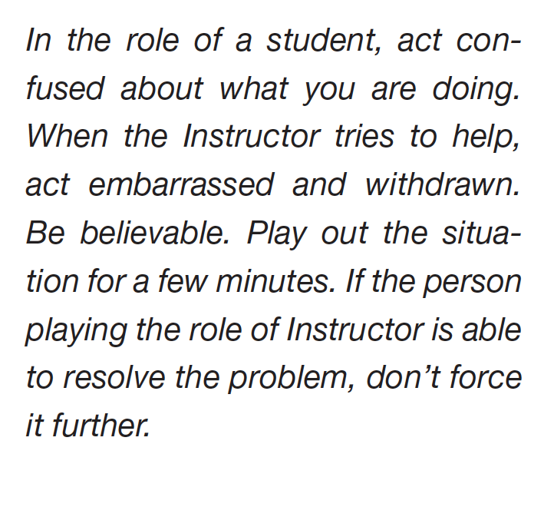
Problem Solving Scenario 4

Slide 54
Conclusion
Exam

Slide 55
Day 2 Wrap-up
Questions?

